Slide 1
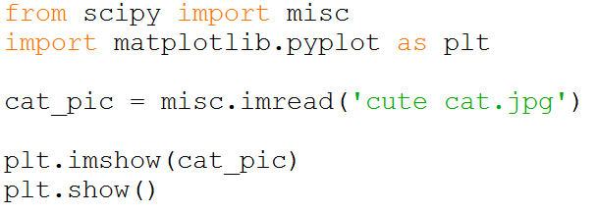
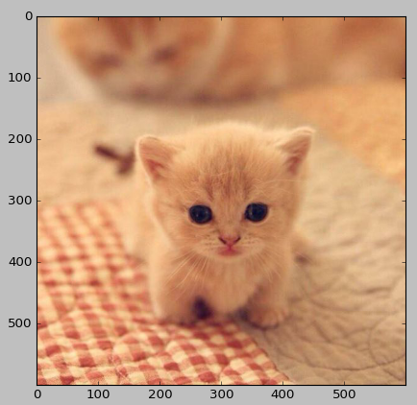
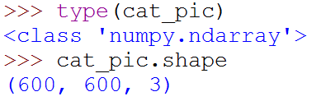
Image Processing
To load an image, you can use the package ‘misc’ in ‘scipy’

Slide 2
Image Processing
Col 0
Col 1
Col 2 ……
Col 599
600 x 600 pixel
[R, G, B]
0 <= R,G,B <=255
Row 0
(R,G,B)
(R,G,B)
(R,G,B)
(R,G,B)
Row 1
(R,G,B)
Row 2
(R,G,B)
.
.
.
.
.
.
Row 599
(R,G,B)
(R,G,B)

Slide 3
Image Processing
600 x 600 pixel
And each pixel has three values of R, G and B
[R, G, B]

Slide 4
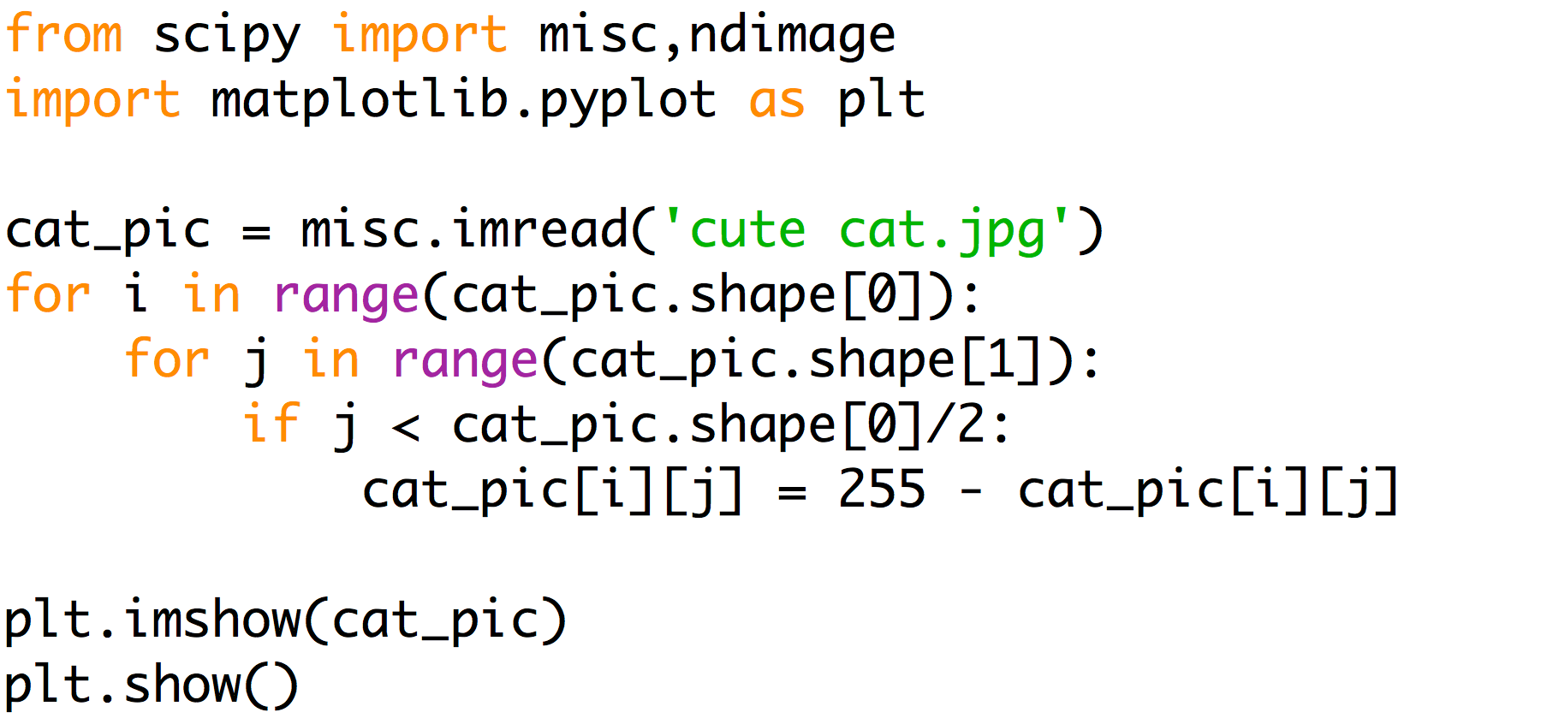
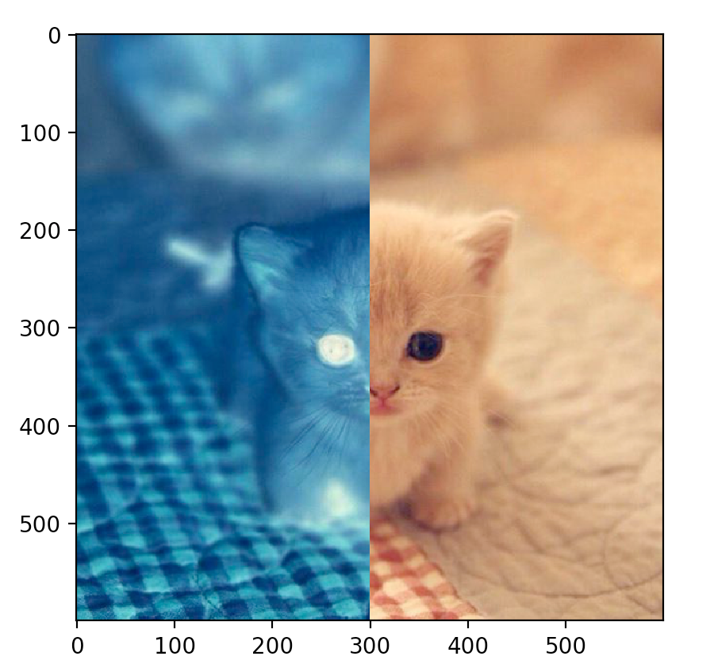
[255, 255, 255] – [R, G, B]
A list of [R, G, B]

Slide 5
For Question 1-4
Please refer to Lecture Notes
in Week 6

Slide 6
Treat a Function like a Variable

Slide 7
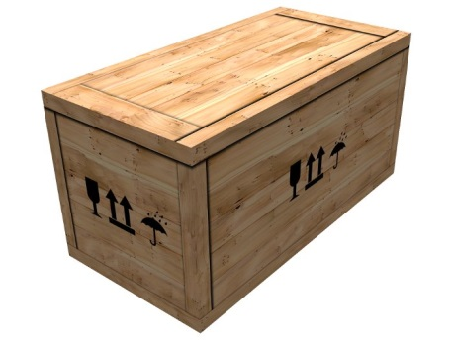
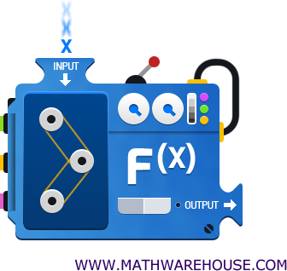
Function
We can put a variable into a function
Can we put a function into a variable?
0

Slide 8
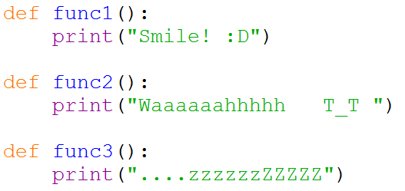
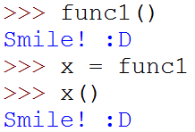
Putting a Function into a Variable
x
func1

Slide 9

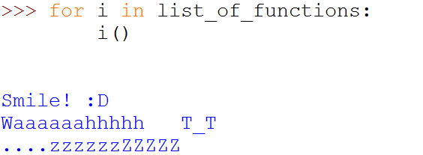
Storing Functions into a List
Accessing a function in a list
Iterate the list of functions like a normal for-loop

Slide 10
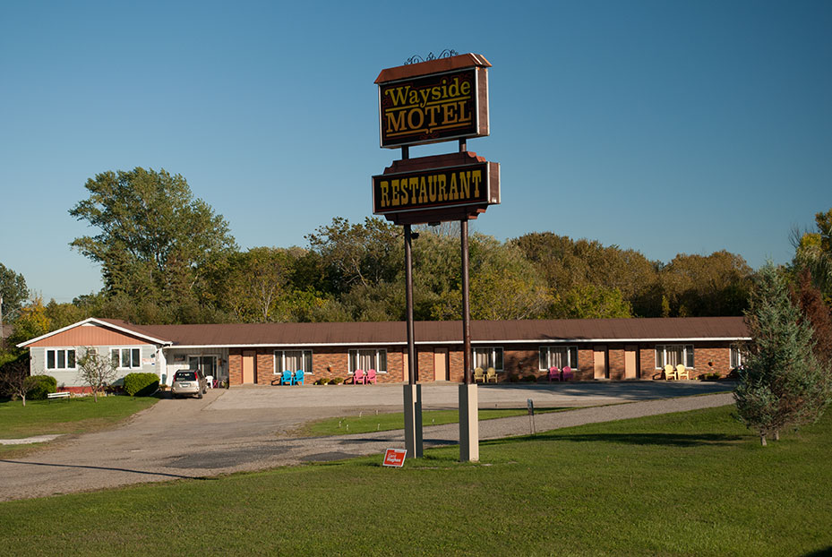
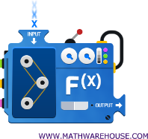

Motel in US
Rm 1
Rm 2
Rm 3
Rm 4
Rm 5
One Dimension

Slide 11
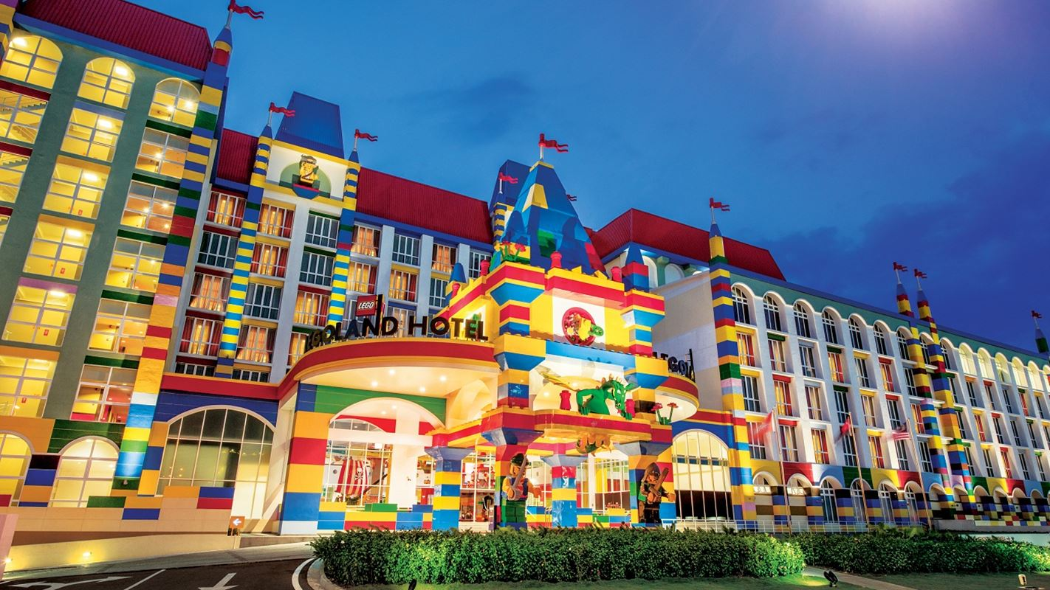


Hotel
My room is 02-05
4F
1
2
3
4
5
6
3F
1
2
3
4
5
6
2F
1
2
3
4
5
6
1F
1
2
3
4
5
6

Slide 12
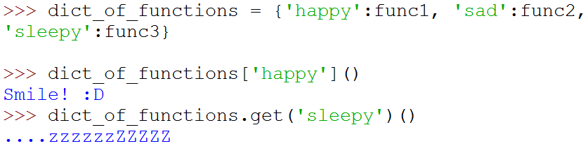
Storing Functions into a Dictionary

Slide 13
Lab 05

Slide 14
You are given
Only one template for both Part A and B
The file you are going to work on
A few more .py files
circle_pic.py
gauss_filter.py
rotate_image.py
in which, you don’t have to, and you are not allowed to modify
A few images, but you can use your own

Slide 15
Hints
Q1, should be easy
Q2, you need to figure out how to determinate the column is “under the black”
Suggestion: You can use the 2D looping method
Q3, just need to determine which are the pixels that contribute to the color of a final pixel with coordinates (x,y)
Q4, similar to Q2

Slide 17
Question 5
Good to follow the tasks one by one
Read through the whole question first
Modularize your code, namely, write a few functions
e.g. print menu is one function
If you are not that confident
Add the operations in the menu and test them one by one

